Slide 1
The minimum concentration of Ca
Conditions:
Current density: 12 mA/cm²
Membrane stack: SCEM
Salt solution composition:
10 ppm, 1 ppm, 0.1 ppm, 0.01 ppm Ca
0 ppm Mg
8.18 g/L Na₂SO₄
0.402 g/L NaHCO₃

Slide 2
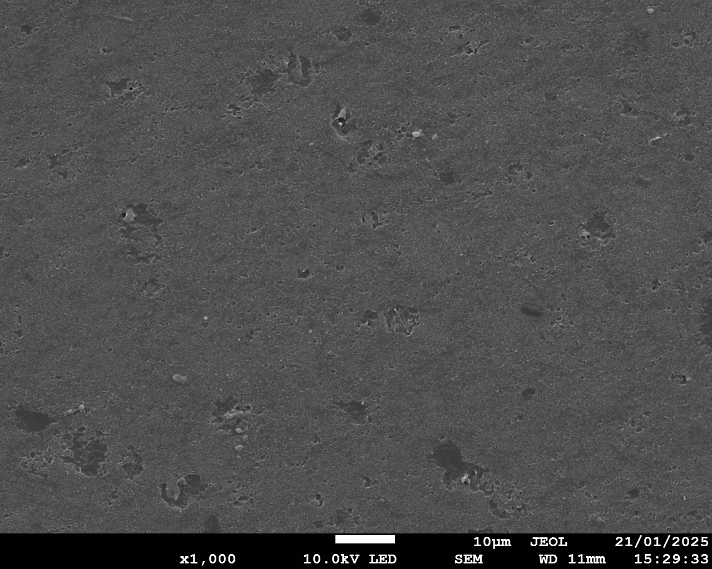
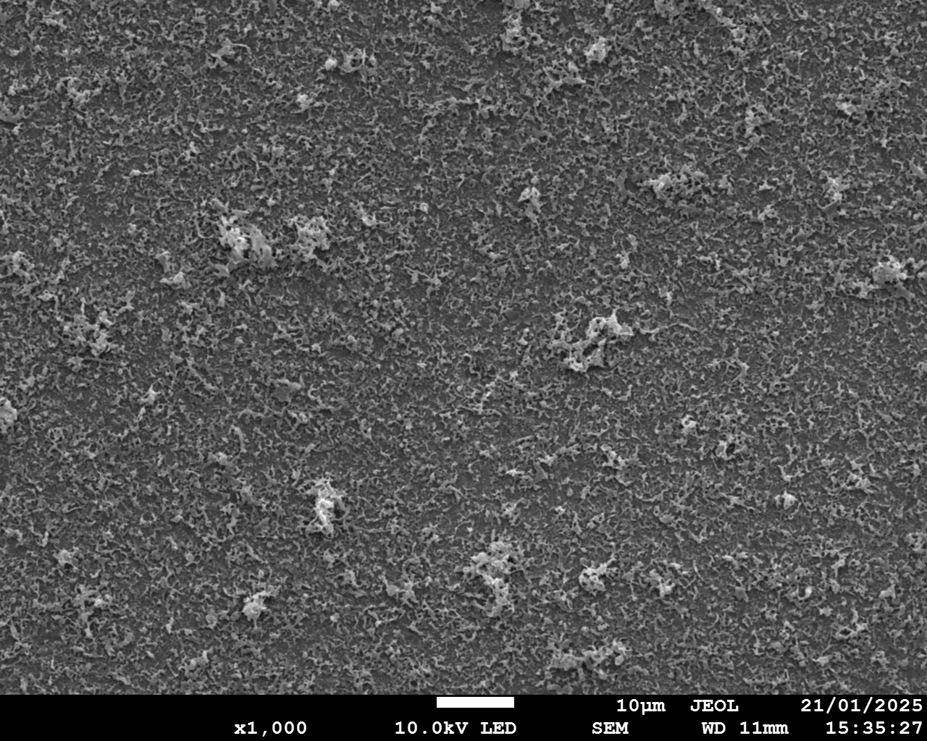
10 ppm Ca
Facing SC
Facing BC

Slide 3
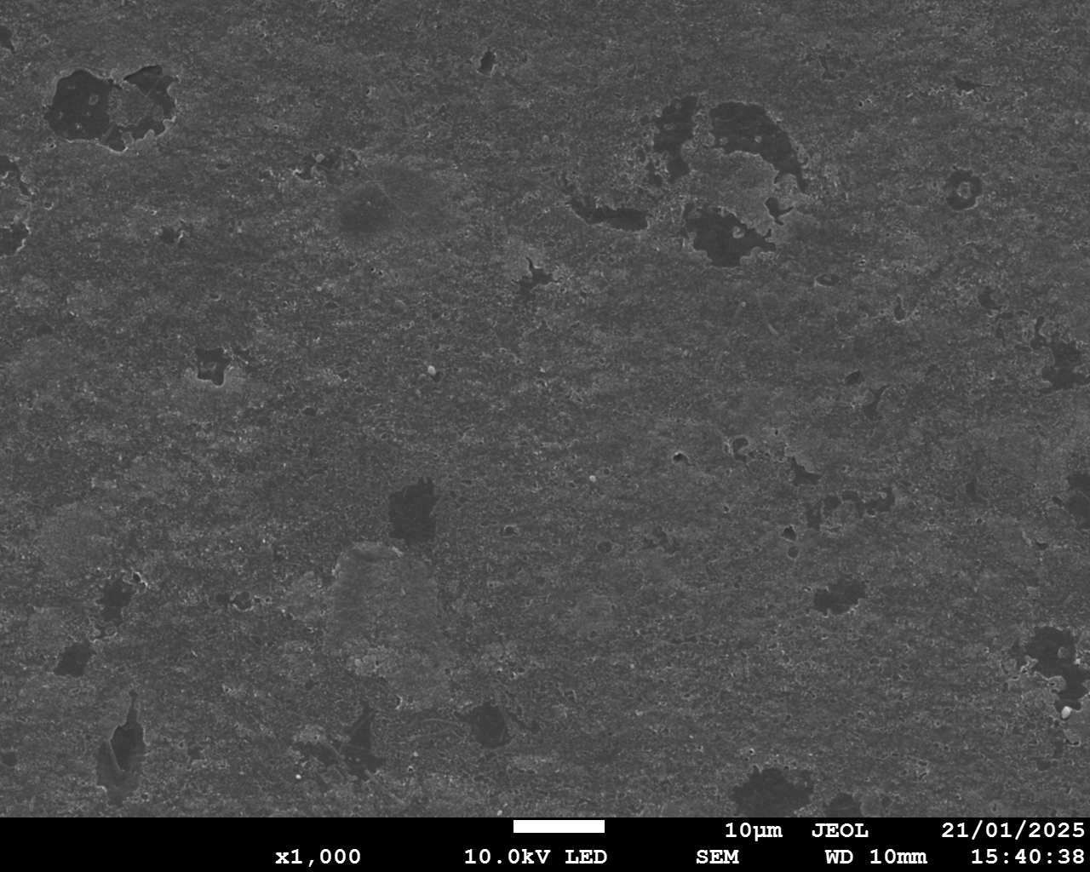
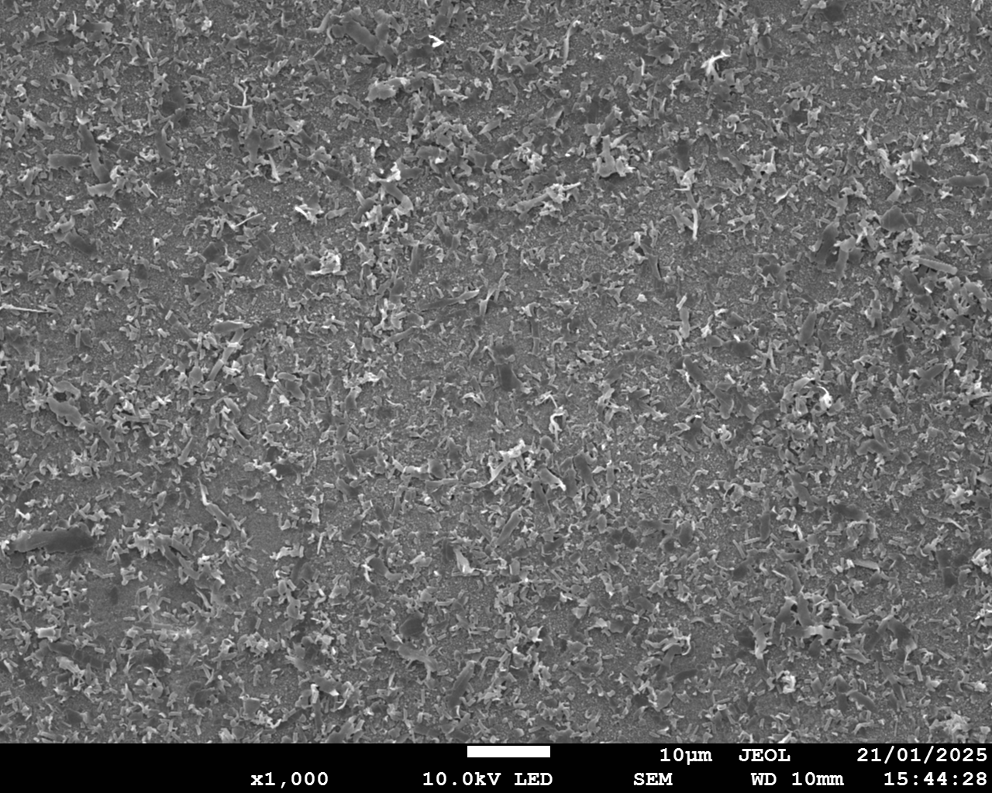
1 ppm Ca
Facing SC
Facing BC

Slide 4
0.1 ppm Ca
Facing SC
Facing BC

Slide 5
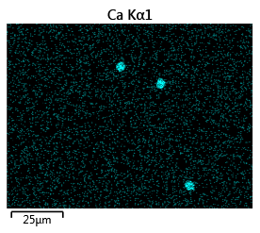
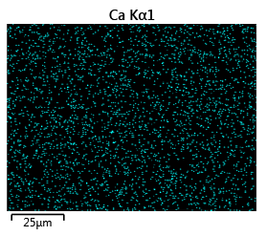
0.01 ppm Ca —— the minimum concentration of Ca
Facing SC
Ca
25 μm
Facing BC
Ca
25 μm

Slide 6
The minimum concentration of Mg
Conditions:
Current density: 12 mA/cm²
Membrane stack: SCEM
Salt solution composition:
50 ppm, 20 ppm, 10 ppm, 1 ppm, 0.1 ppm, 1 ppb Mg
0 ppm Ca
8.18 g/L Na₂SO₄
0.402 g/L NaHCO₃

Slide 7
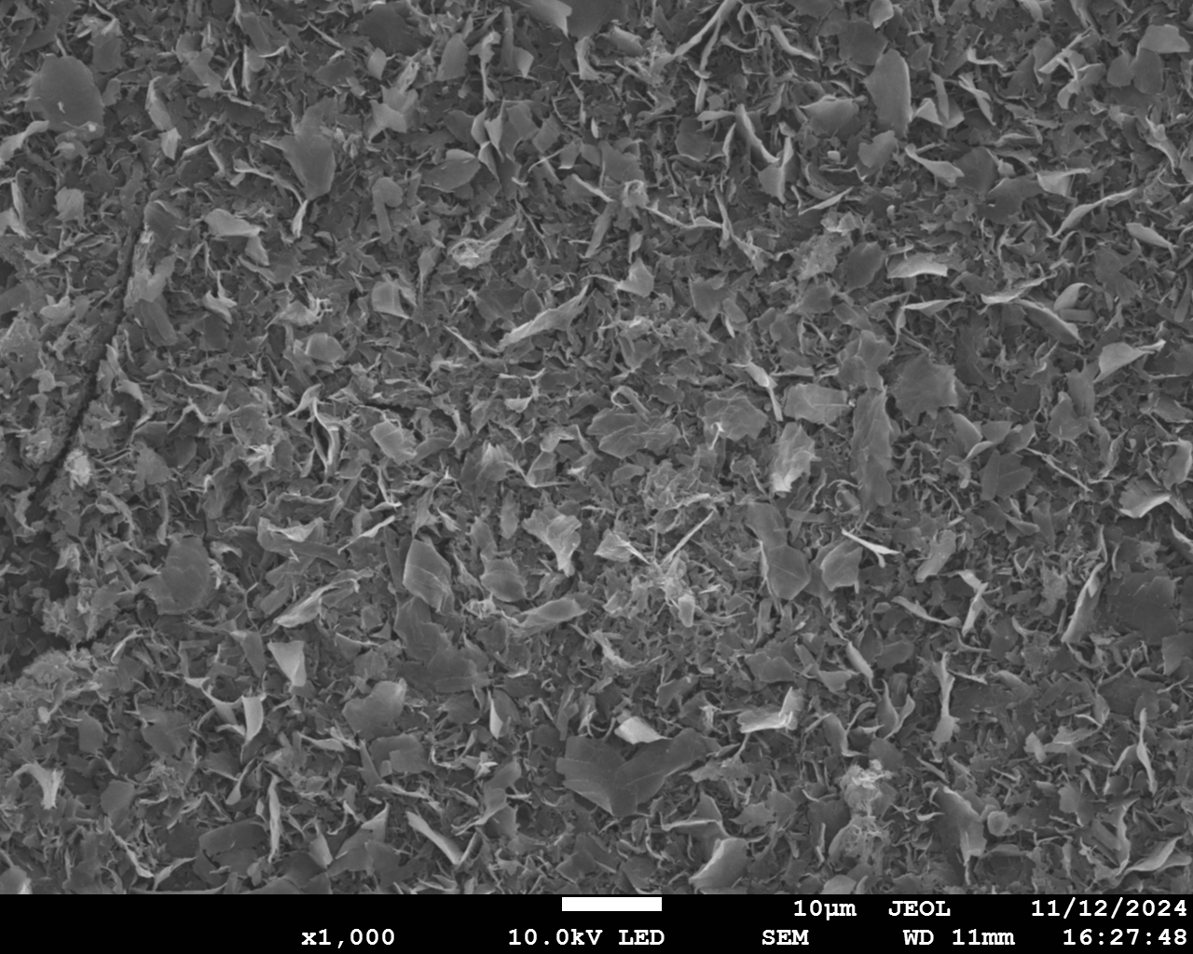
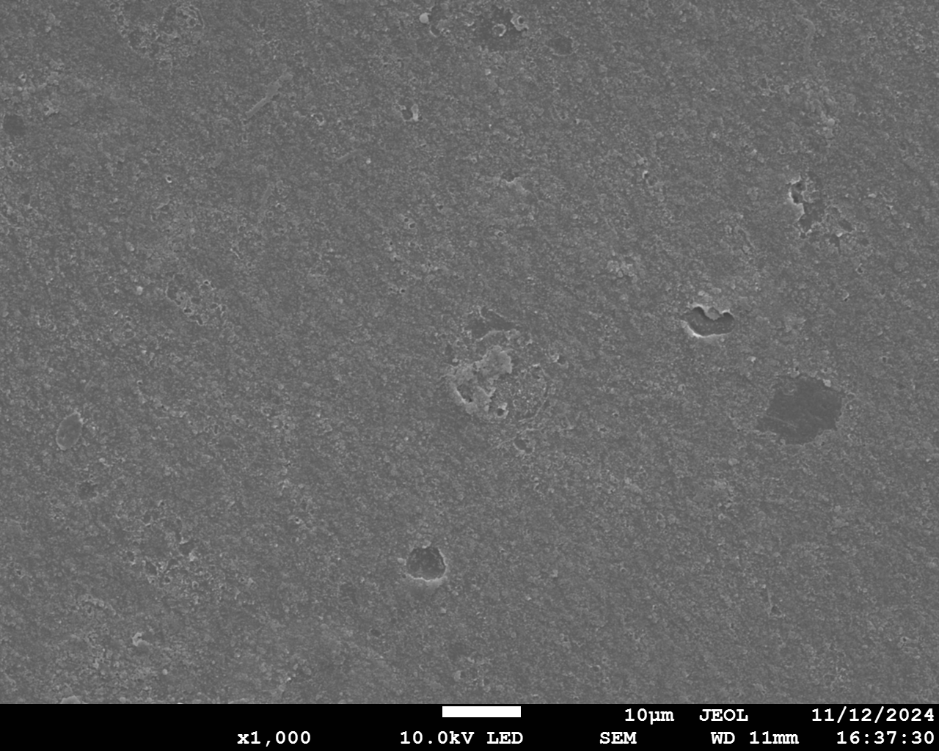
50 ppm Mg
Facing SC
Facing BC

Slide 8
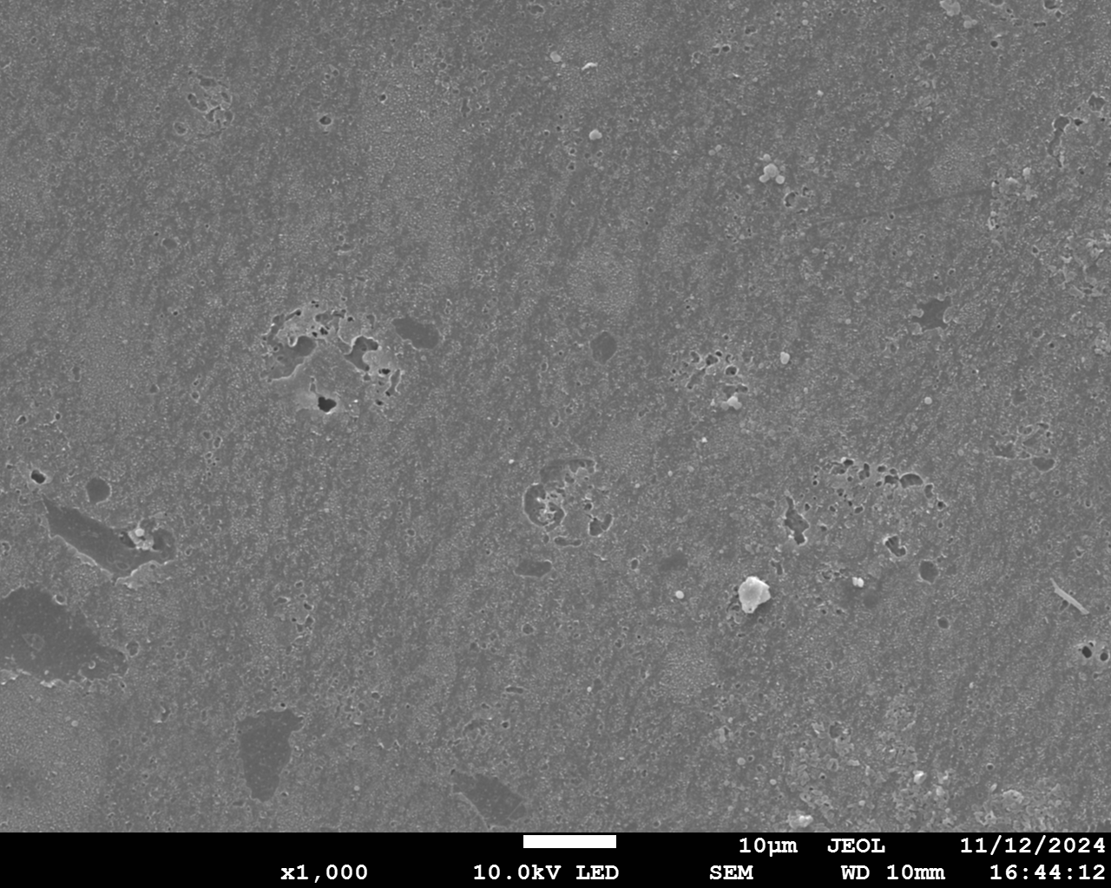
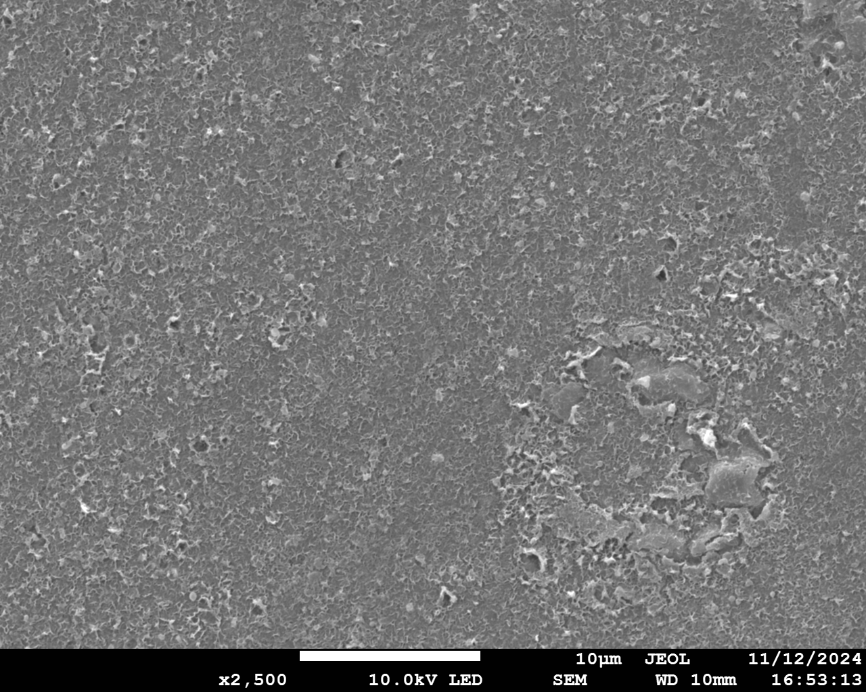
20 ppm Mg
Facing SC
Facing BC

Slide 9
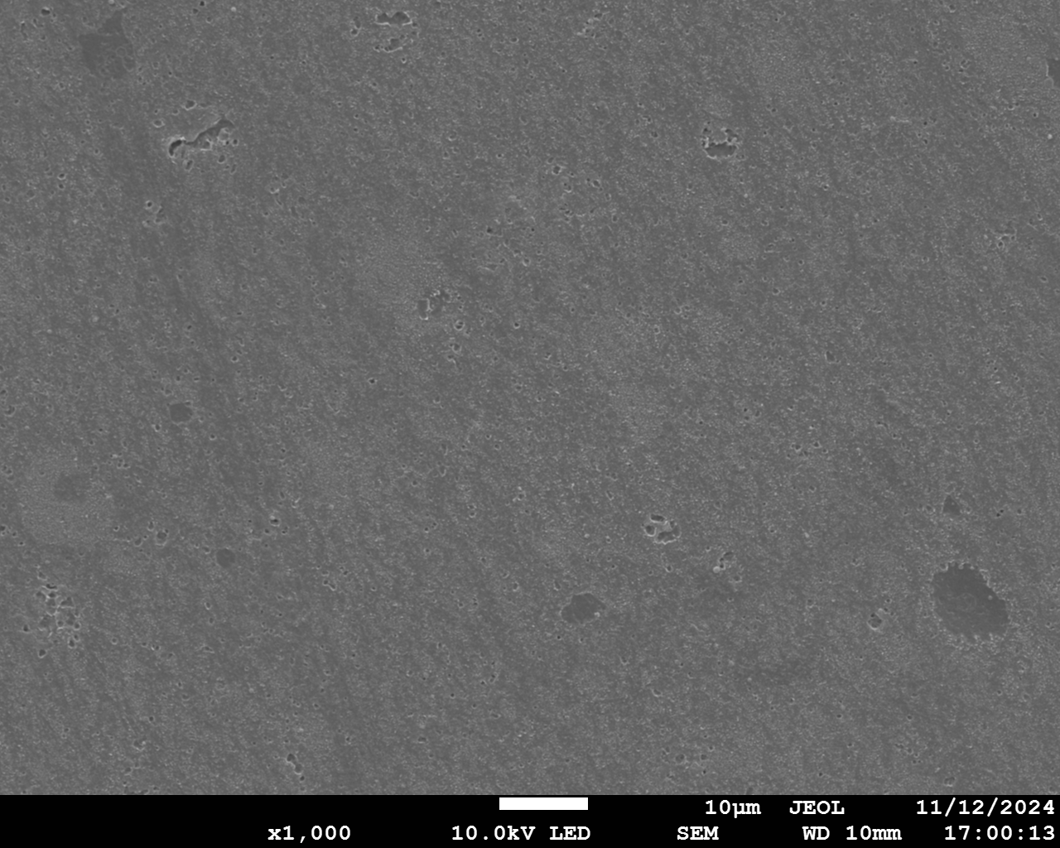
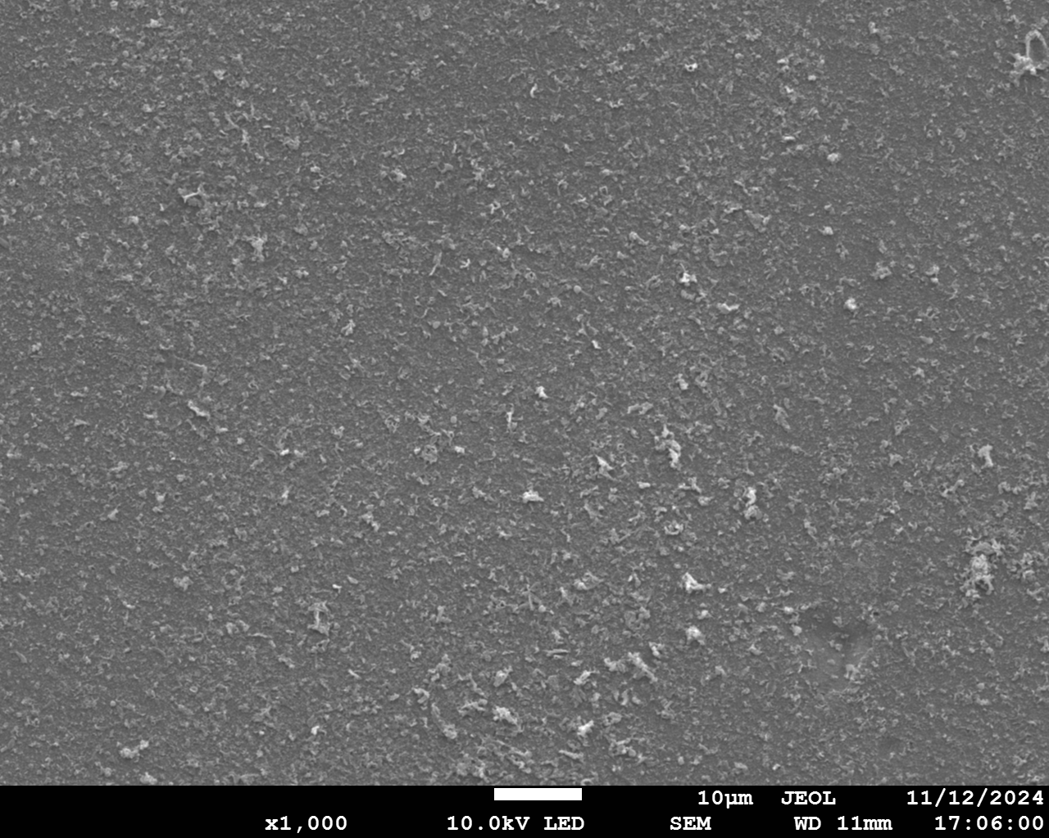
10 ppm Mg
Facing SC
Facing BC

Slide 10
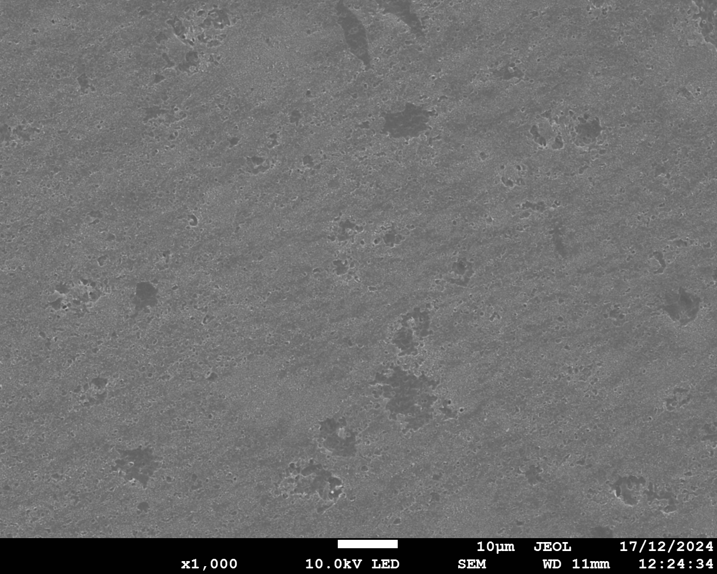
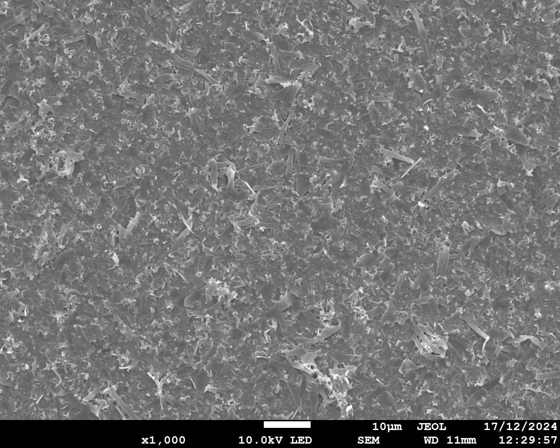
1 ppm Mg
Facing SC
Facing BC

Slide 11
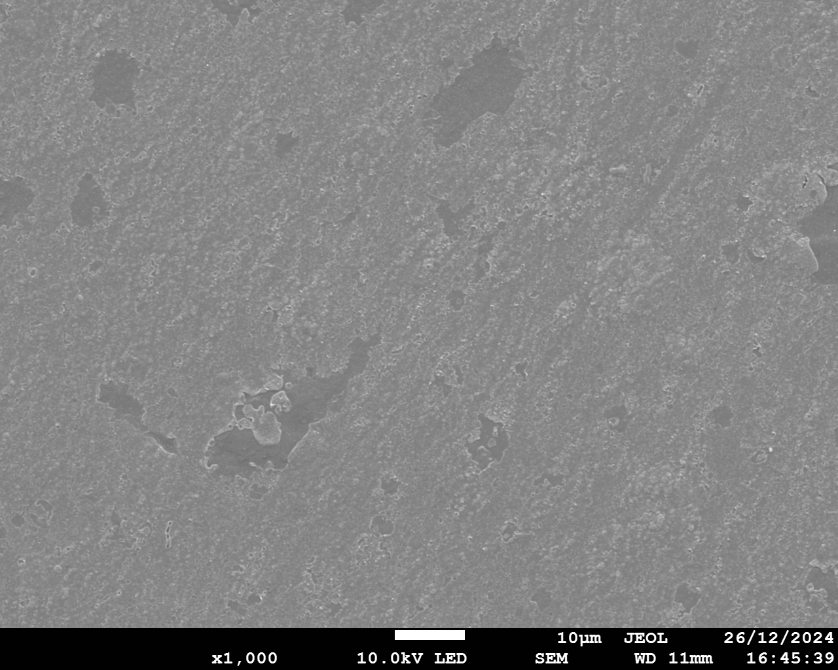
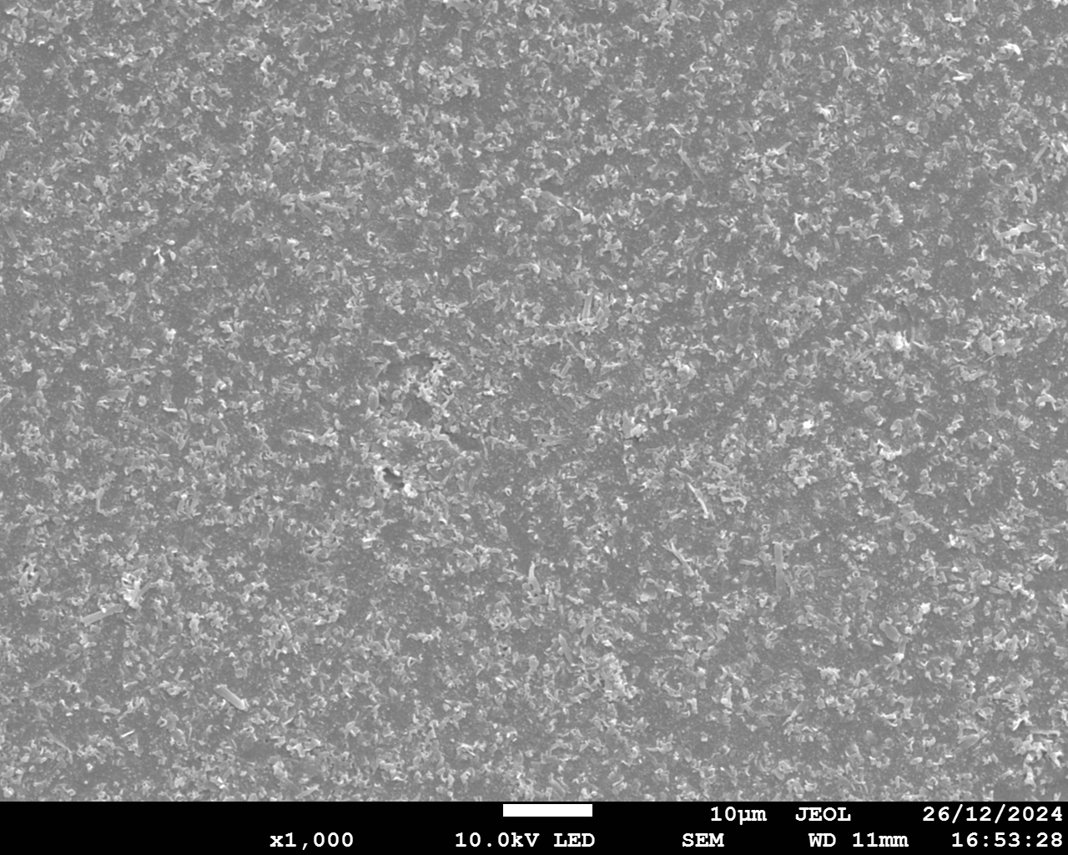
0.1 ppm Mg
Facing SC
Facing BC

Slide 12
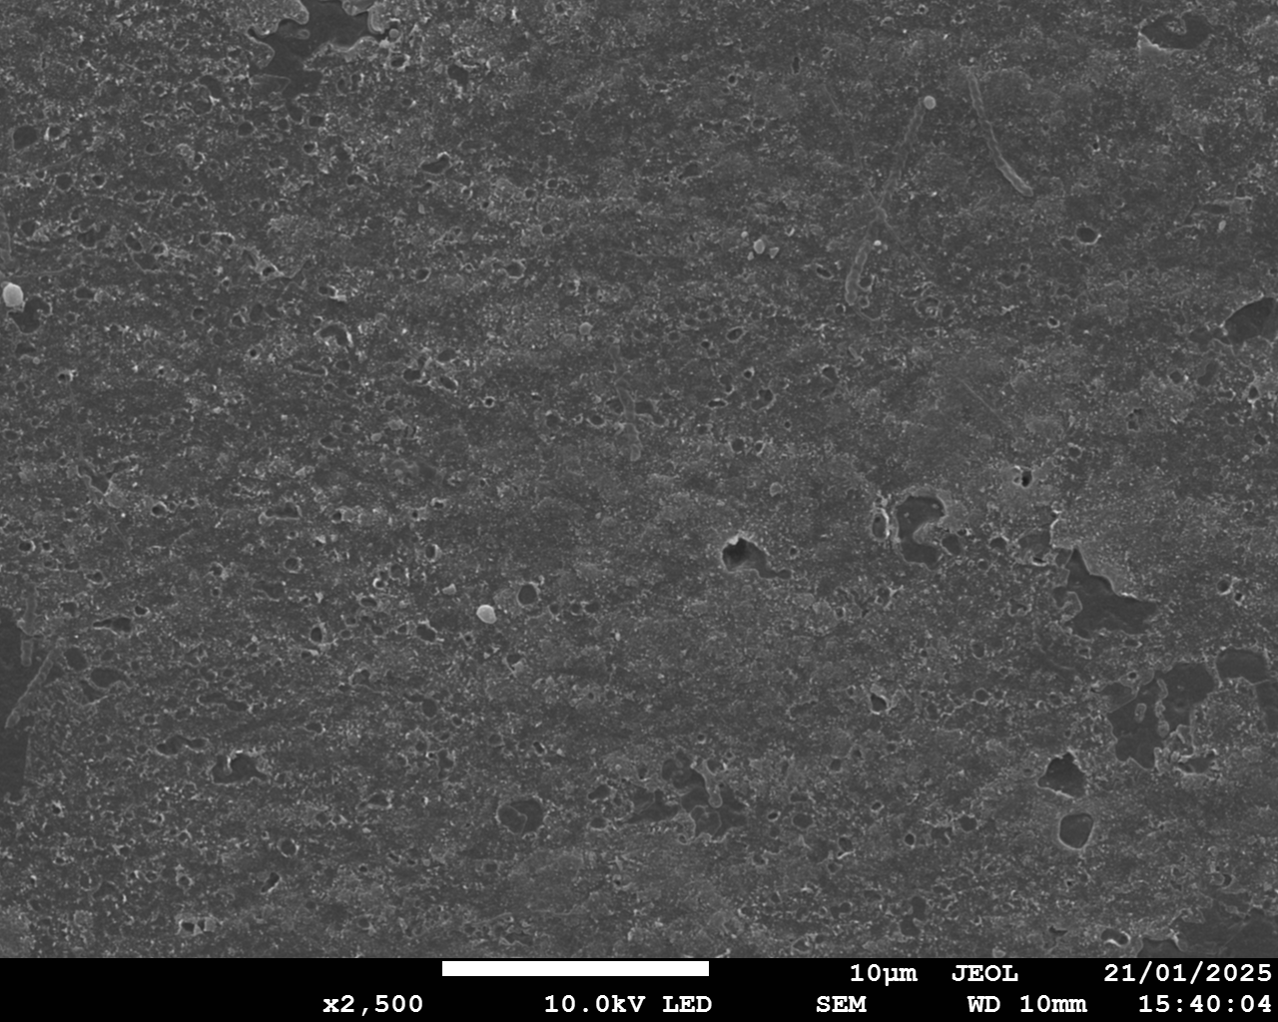
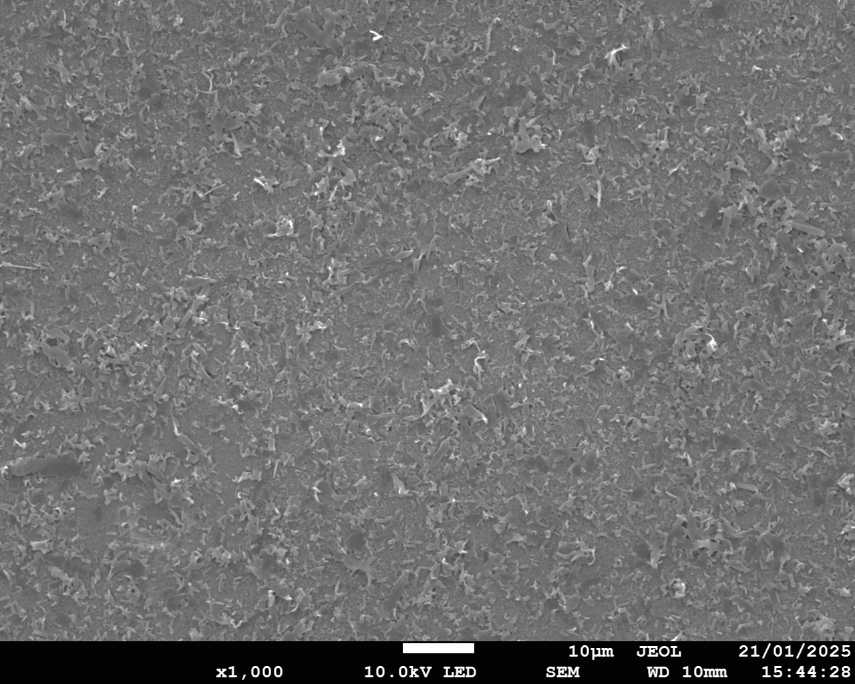
0.01 ppm Mg
Facing SC
Facing BC

Slide 13
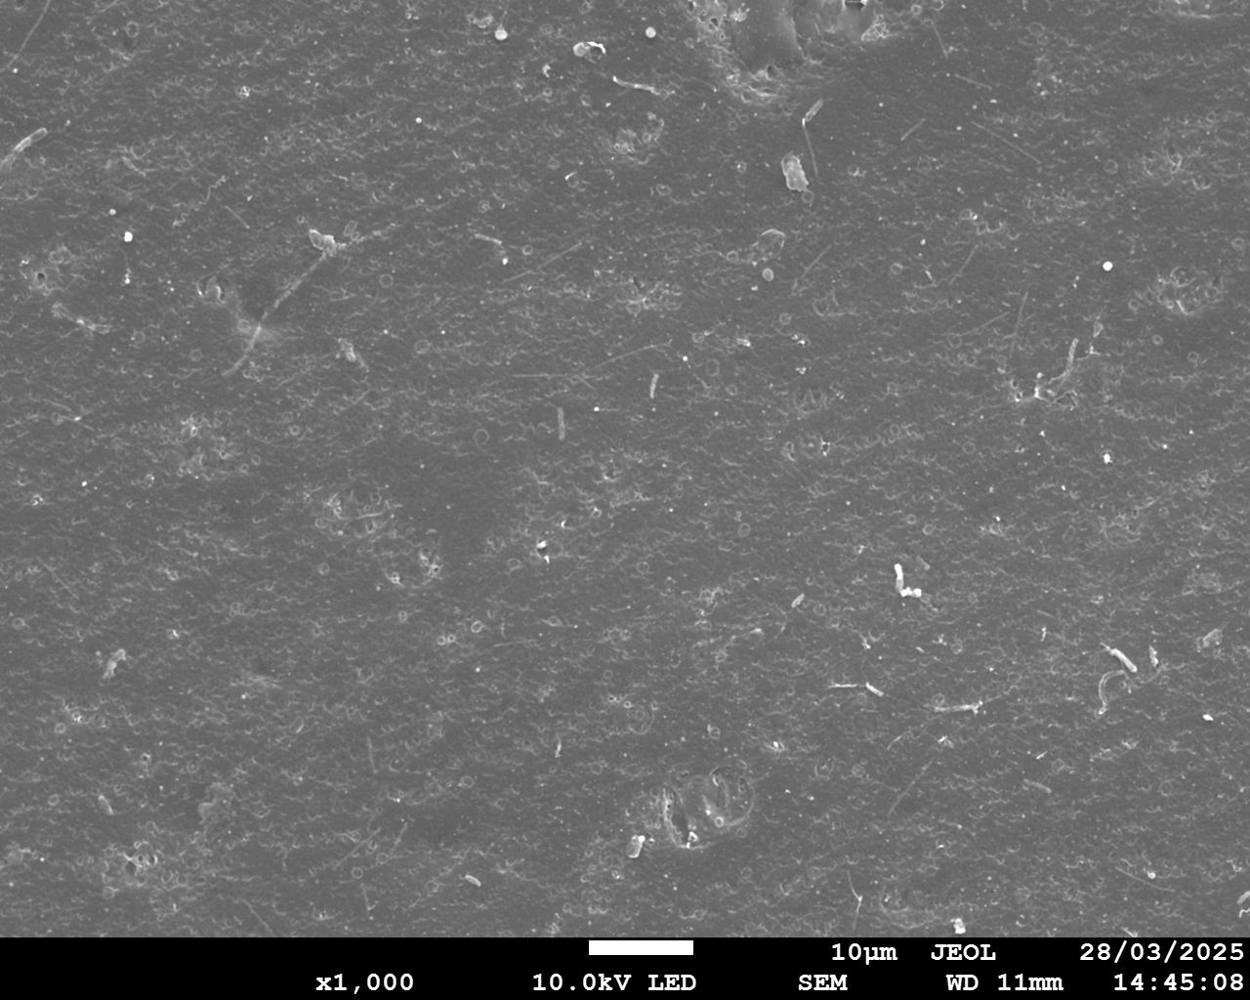
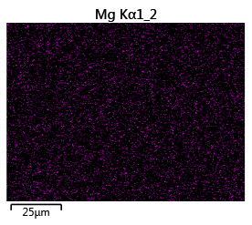
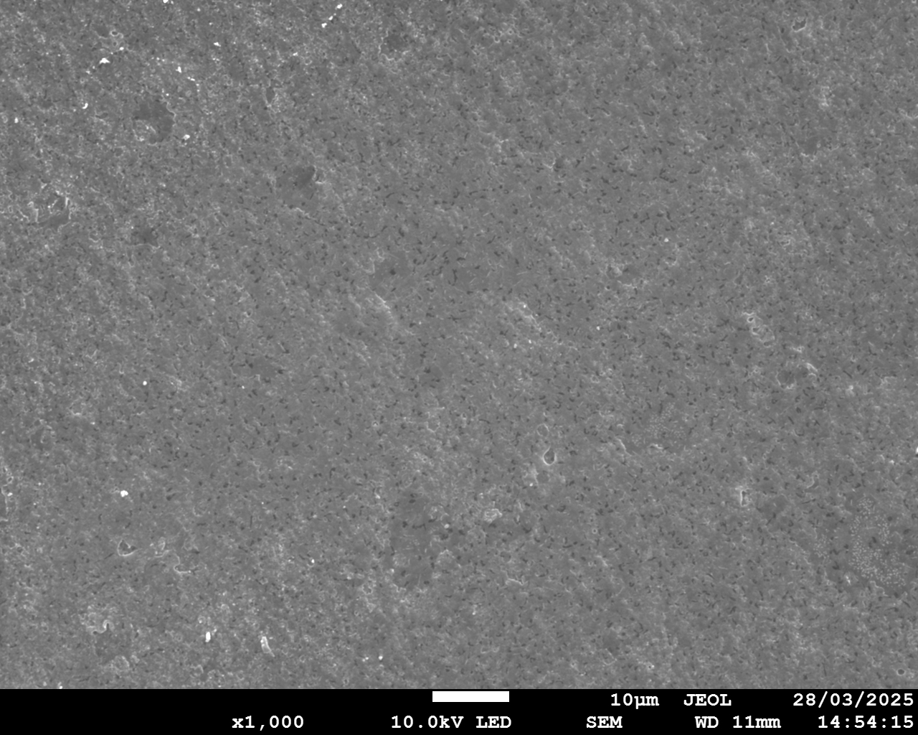
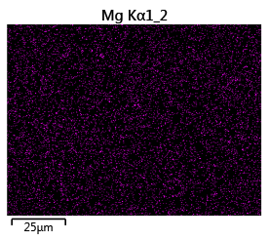
1 ppb Mg—— the minimum concentration of Mg
Facing SC
Mg
25 μm
Facing BC
Mg
25 μm

